Slide 1
Coca Cola Stock Analysis & Machine Learning
Exploratory Data Analysis | Regression & Classification | ML Model

Slide 2
Objective
Perform exploratory data analysis (EDA) on historical stock price data to understand trends and patterns
Engineer time-based and lagged features to capture temporal dependencies in stock price movements
Build classification models to predict the direction of stock price movement (Up or Down)
Develop an ARIMA time series model to forecast adjusted closing prices for future periods
Evaluate classification models using metrics such as accuracy, precision, recall, and F1-scoreAssess ARIMA forecasting performance using RMSE and MAPE metrics
Visualize data trends, decomposition components, model predictions, and future forecasts through comprehensive plots

Slide 3
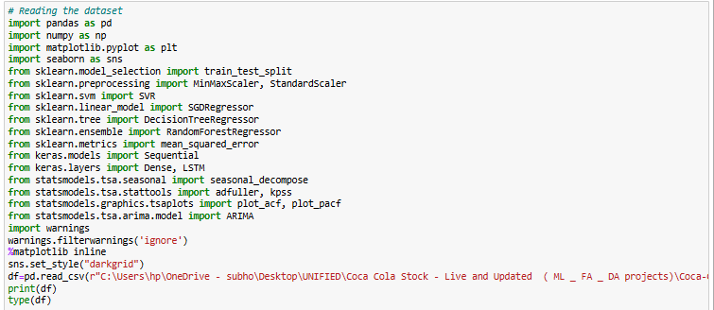
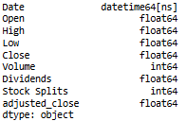
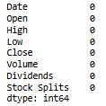
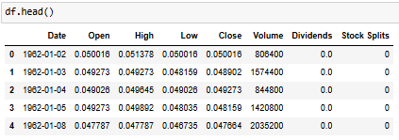

Dataset Overview
Loaded using pandas Columns types
Missing values checked Head (5)
Number of rows and column

Slide 4
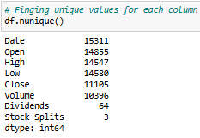
Unique values for each column

Slide 5
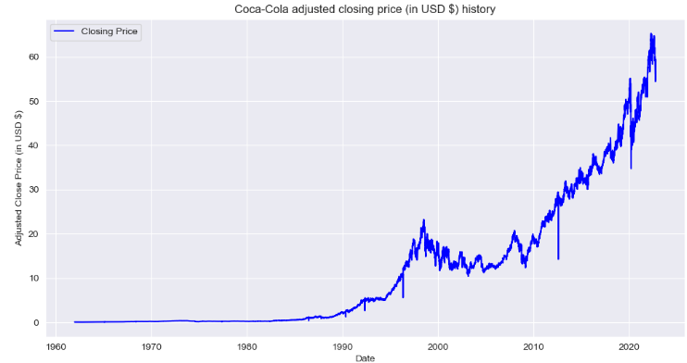
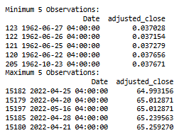
Trend of Adjusted Closing Price History (Daily View)
Observation: The adjusted closing price showed a steady increase from 1962 to 2022, starting around $0.037 and peaking at over $65. This reflects Coca-Cola's long-term growth and strong market performance over six decades.

Slide 6
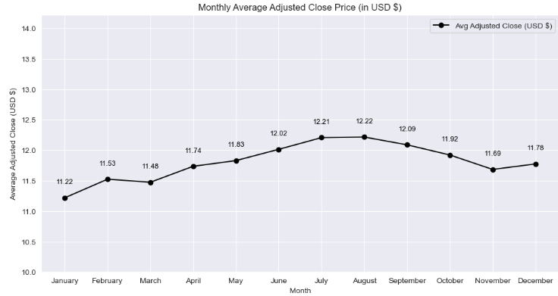
Trend of Adjusted Closing Price History (Monthly Average)
Observation: The monthly average adjusted close price shows a steady rise from January to August, peaking at $12.22. Although there is a slight dip from September to November, the price remains relatively stable, indicating overall market resilience.

Slide 7
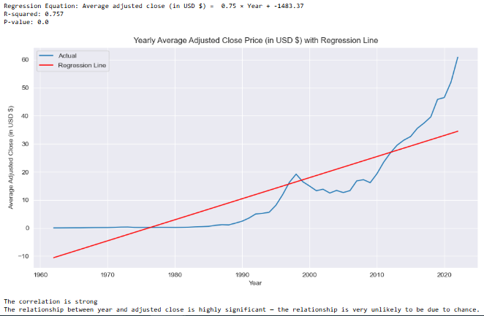
Yearly Average Adjusted Closing Price with Trend Line (Regression)
Observation: There is a strong positive linear trend in the yearly average adjusted closing price, with an R² of 0.757.The regression indicates a statistically significant rise in price over time, confirming long-term value growth.

Slide 8

Maximum High Price Points in the Dataset
Observation: The dataset shows peak high prices clustered around April–May 2022, with the highest value reaching $66.24. This indicates a significant surge in Coca-Cola's stock during this period, possibly due to market or company-specific events.

Slide 9

Minimum Low Price Points in the Dataset
Observation: The lowest recorded stock prices occurred in mid-1962, with the minimum low reaching $0.0349. This reflects the historical starting point of Coca-Cola's stock, highlighting its substantial growth over the decades.

Slide 10
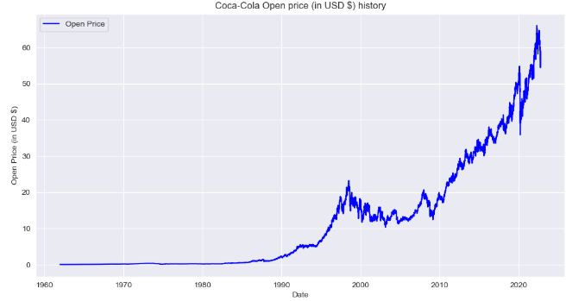
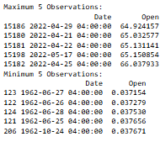
Trend of Adjusted Opening Price History (Daily View)
Observation : The adjusted opening prices show a significant increase from the early 1960s, starting around $0.037. Recent data from 2022 indicates a peak opening price above $66, reflecting strong long-term growth.

Slide 11
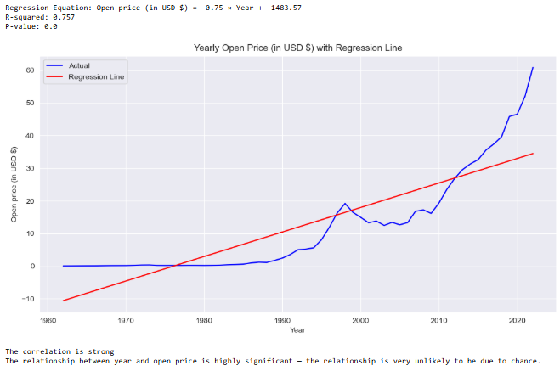
Yearly Average Open Price with Trend Line (Regression)
Observation: The yearly average opening price shows a strong upward trend over the years, supported by a high R-squared value of 0.757. The significant p-value (0.0) confirms that the increase in open price over time is statistically meaningful and unlikely due to random chance.

Slide 12
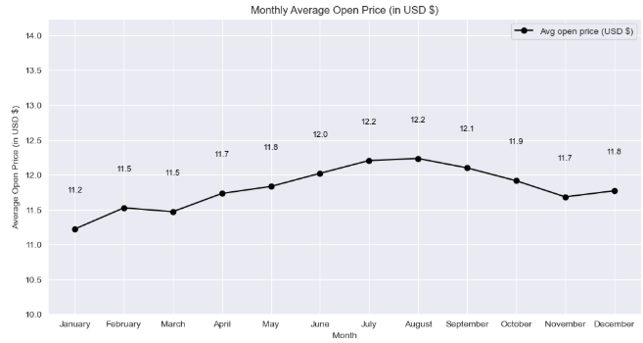
Monthly Average Open Price Trend
Observation: The monthly average open price shows a rising trend from January ($11.20) to a peak in August ($12.20), mirroring the adjusted close price trend. Post-August, a gradual decline is observed through November, before a slight recovery in December. This pattern reflects a typical mid-year peak and end-year stabilization in market behavior.

Slide 13
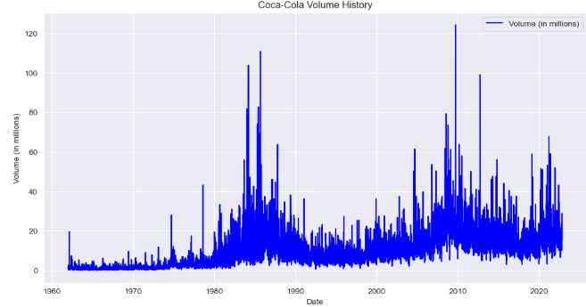
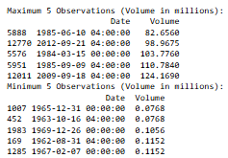
Trend of Volume Traded (Daily View)
Observation : The daily trading volume shows substantial growth over the years, with peak volumes reaching over 124 million shares traded. Early years recorded very low volumes, often below 0.2 million, indicating much lower market activity in the initial decades.

Slide 14
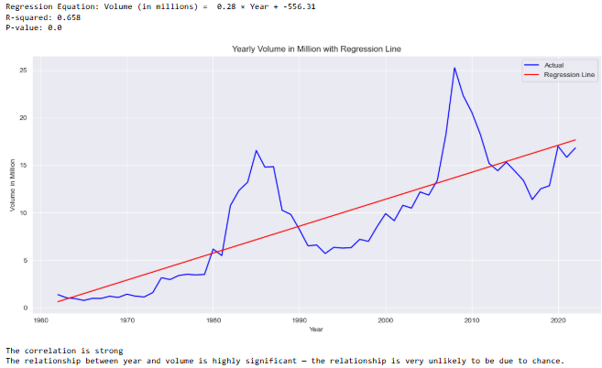
Yearly Average Volume (in Millions) with Trend Line (Regression)
• Observation: The yearly average trading volume has shown a strong upward trend over time, with volumes increasing steadily each year. Statistical analysis confirms this relationship is highly significant and unlikely to be due to random chance.

Slide 15
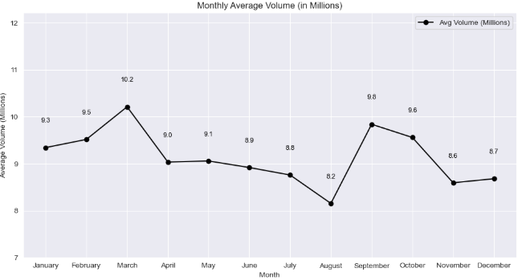
Monthly Average Volume Trend (in Millions)
• Observation: The monthly average trading volume exhibits noticeable fluctuations throughout the year. A relatively lower volume is seen in the mid months, with a gradual increase peaking around early-year (typically Feb–Mar). Following this, a declining trend is observed towards the end of the year, indicating reduced market activity, possibly due to seasonal slowdowns or investor caution during year-end periods.

Slide 16




Machine Learning – regression model
• Observation: Created key time-related features (day, month, weekday) and encoded categorical data to capture seasonality and trends. Added lagged adjusted close prices to incorporate past price influence, enhancing model predictive power.
REGRESSION RANDOM FOREST MODEL REGRESSION SVR MODEL
REGRESSION SGD MODEL REGRESSION MODEL LSTM

Slide 17
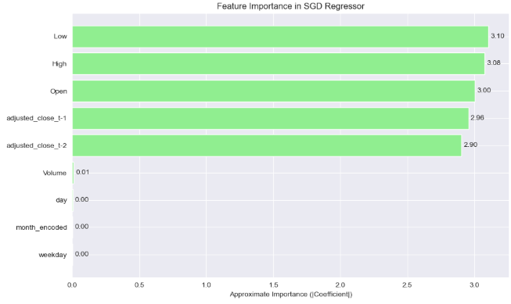
Feature importance in SGD
Observation : The most important features influencing the SGD model are Low, High and Open. These features play a key role in predicting coca cola stock effectively.

Slide 18
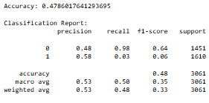
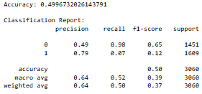
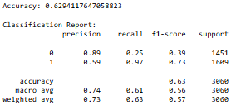
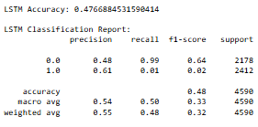
Machine Learning – classification model
• Observation: Created time-related features such as day, month, weekday, and lagged adjusted close values to capture trends and seasonality. Encoded categorical data (month names) and defined a binary target for price direction (up/down) to enhance model performance.
CLASSIFICATION RANDOM FOREST MODEL CLASSIFICATION SVC MODEL
CLASSIFICATION SGD MODEL CLASSIFICATION MODEL LSTM

Slide 19
Models
Regression and classification models were applied to predict and classify stock price movement direction using features such as open, high, low prices, volume, date components, and lagged adjusted close values.
Regression models – Regression models were trained using extensive feature engineering including date components (day, month, weekday), encoded month names, and lagged adjusted close prices to capture temporal patterns. Among the models, the LSTM achieved the best performance with an RMSE of 2.42 and R² of 0.97, demonstrating excellent predictive accuracy for stock prices. The Random Forest Regressor showed moderate results with an RMSE of 18.05 and a negative R², indicating poor fit, while the SGD Regressor surprisingly achieved strong results with an RMSE of 0.43 and R² of 0.998, likely due to effective feature scaling and linear assumptions. The SVR model performed poorly, with high RMSE (28.36) and negative R², indicating limited predictive capability. Overall, deep learning and well-scaled linear models outperformed traditional ensemble and kernel-based regressors in this task.
Classification models – Among the classification models tested for predicting stock price direction, the SGD Classifier achieved the highest accuracy of 62.94% and demonstrated a strong recall of 0.97 for upward price movement, indicating effective identification of positive trends. The Support Vector Classifier (SVC) and Random Forest Classifier yielded similar moderate accuracies around 48-50%, but both struggled with recall on the minority class, reflecting challenges with class imbalance. The LSTM model also showed comparable accuracy (~47%) and high recall for the majority class, yet poor detection of downward movement. Overall, the classification models exhibited moderate predictive ability, with linear models like SGD outperforming more complex ensemble and deep learning approaches in this scenario, though class imbalance impacted performance, particularly in minority class recall and F1 scores.

Slide 20
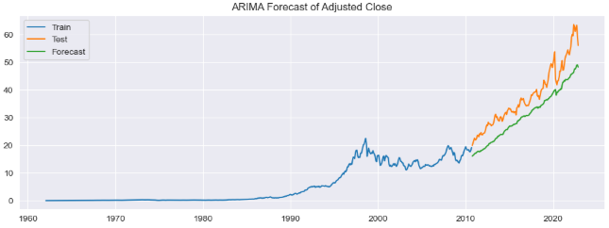
Time Series (ARIMA MODEL)
• Observation: The ARIMA model effectively captures the long-term growth trend in Coca-Cola’s stock prices. Its smooth forecast provides a reliable estimate for future performance, especially for strategic long-term planning.

Slide 21
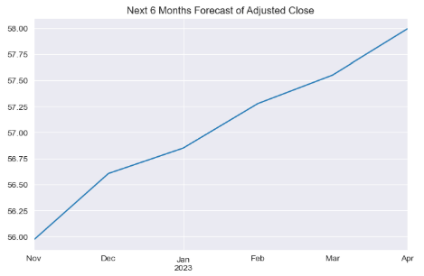
Forecasting for next 6 months
• Observation: The 6-month forecast for Coca-Cola’s adjusted close price shows a steady upward trend, indicating consistent positive growth. This suggests strong market confidence and potential long-term value for investors.

Slide 22
Final Observations & Storyline
The adjusted closing price of Coca-Cola stock rose dramatically from $0.037 in 1962 to a peak of $66.24 in April–May 2022. This represents over 1,700-fold growth, highlighting strong long-term shareholder value and market confidence over six decades. Monthly averages show a rise from $11.20 in January to $12.22 in August, followed by a slight decline, indicating seasonal market trends.
Yearly average adjusted closing prices follow a statistically significant upward trend with an R² of 0.757 and p-value < 0.001. This confirms consistent annual price growth, reflecting Coca-Cola’s expanding market presence and sustained brand strength. The upward trend is mirrored in adjusted opening prices, which also rose from $0.037 to above $66 over the same period.
Monthly average opening prices peak at $12.20 in August, then decline slightly before stabilizing in December, closely following the adjusted close price trends. Trading volume increased significantly from under 0.2 million daily shares in early years to peaks over 124 million shares recently, indicating greater market liquidity and investor participation.
Yearly average trading volume shows a strong upward trend, statistically significant and aligned with Coca-Cola’s growing market capitalization. Monthly volumes peak early in the year (February–March) and taper off toward year-end, reflecting typical seasonal trading patterns and investor behavior. The historic low price of $0.0349 in 1962 contrasts sharply with recent highs, emphasizing massive long-term appreciation.
Overall, Coca-Cola stock demonstrates resilience with strong price appreciation, increasing liquidity, and predictable seasonal volume patterns. These trends underscore the company’s status as a stable, blue-chip investment with a proven track record of delivering value over time.

